Slide 1
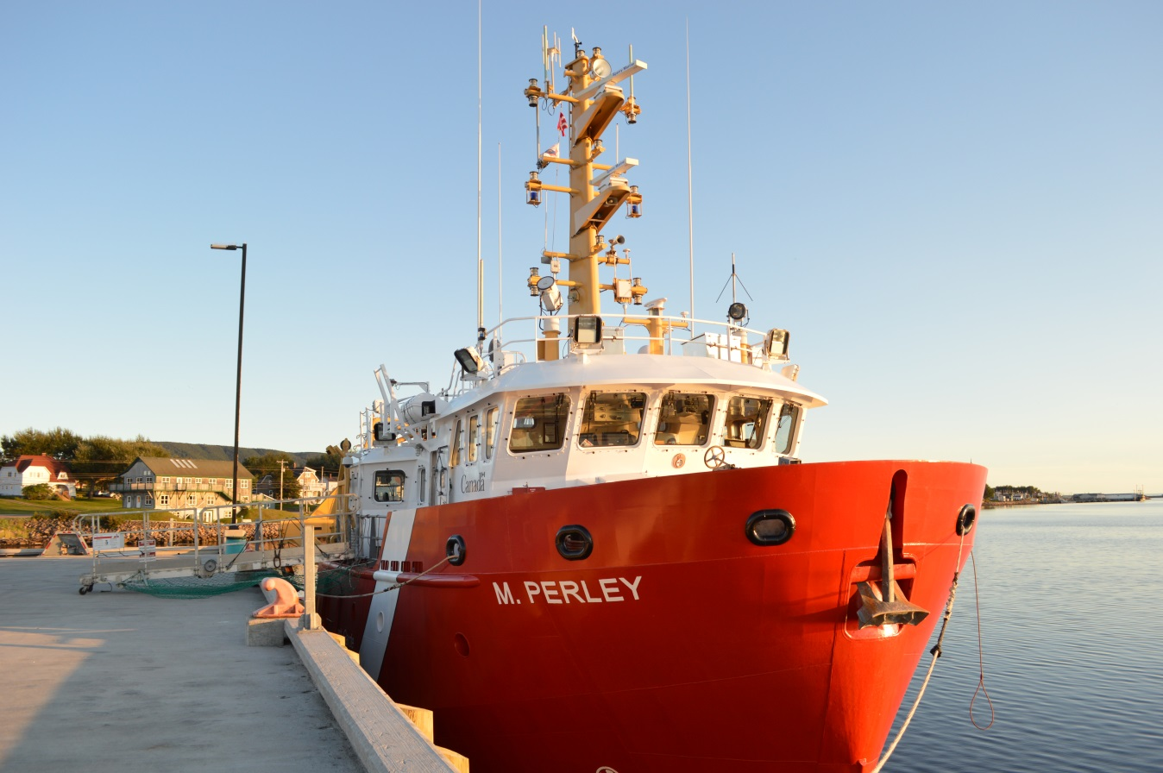
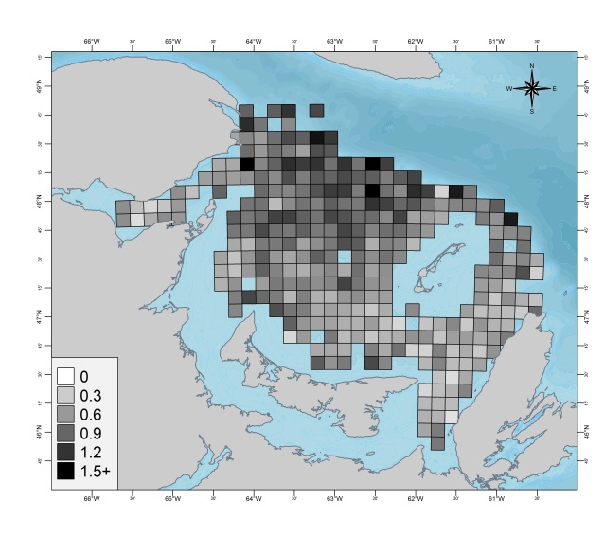
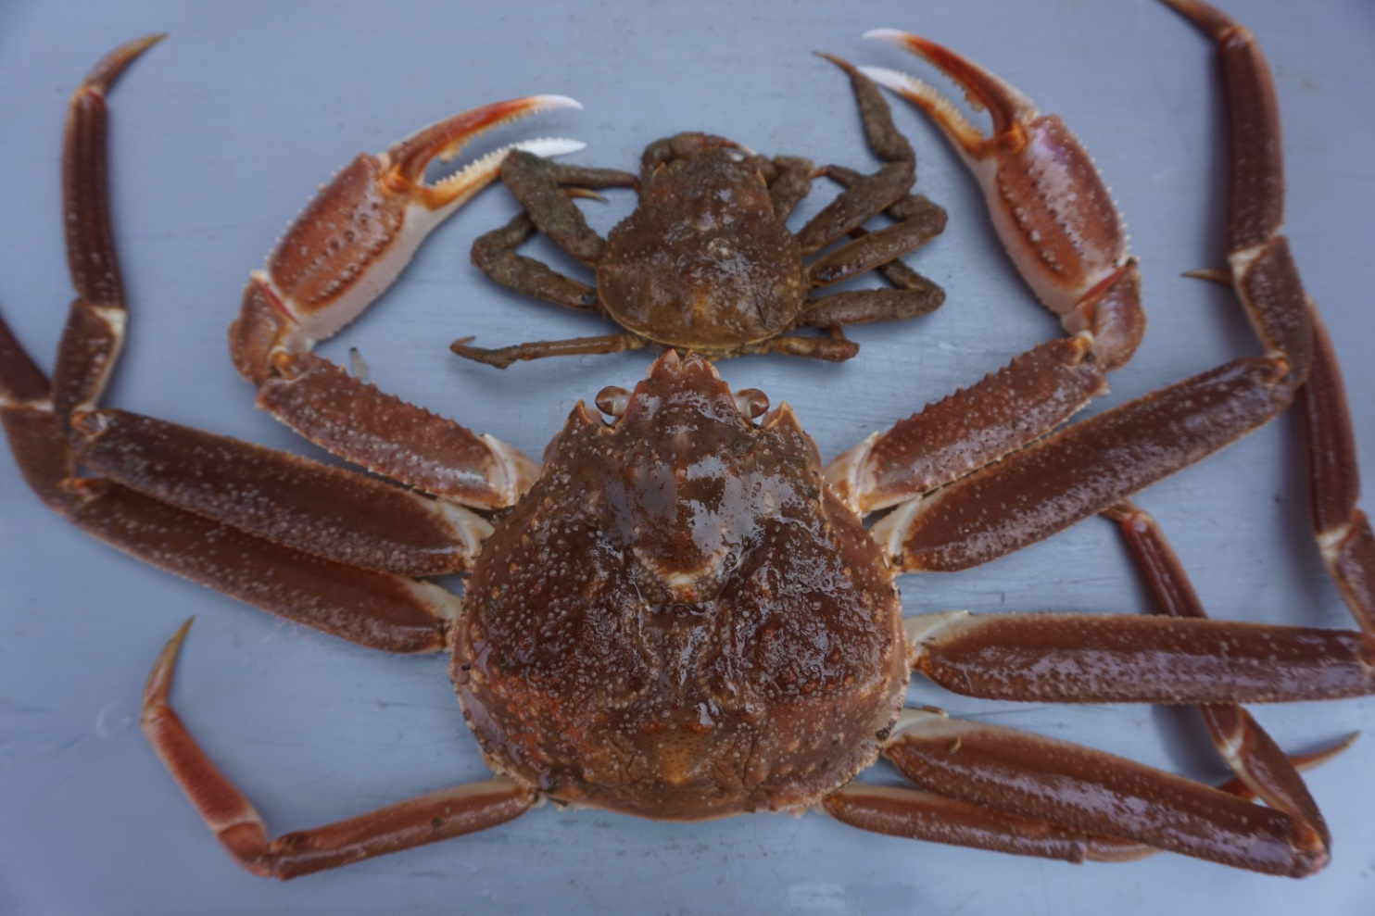
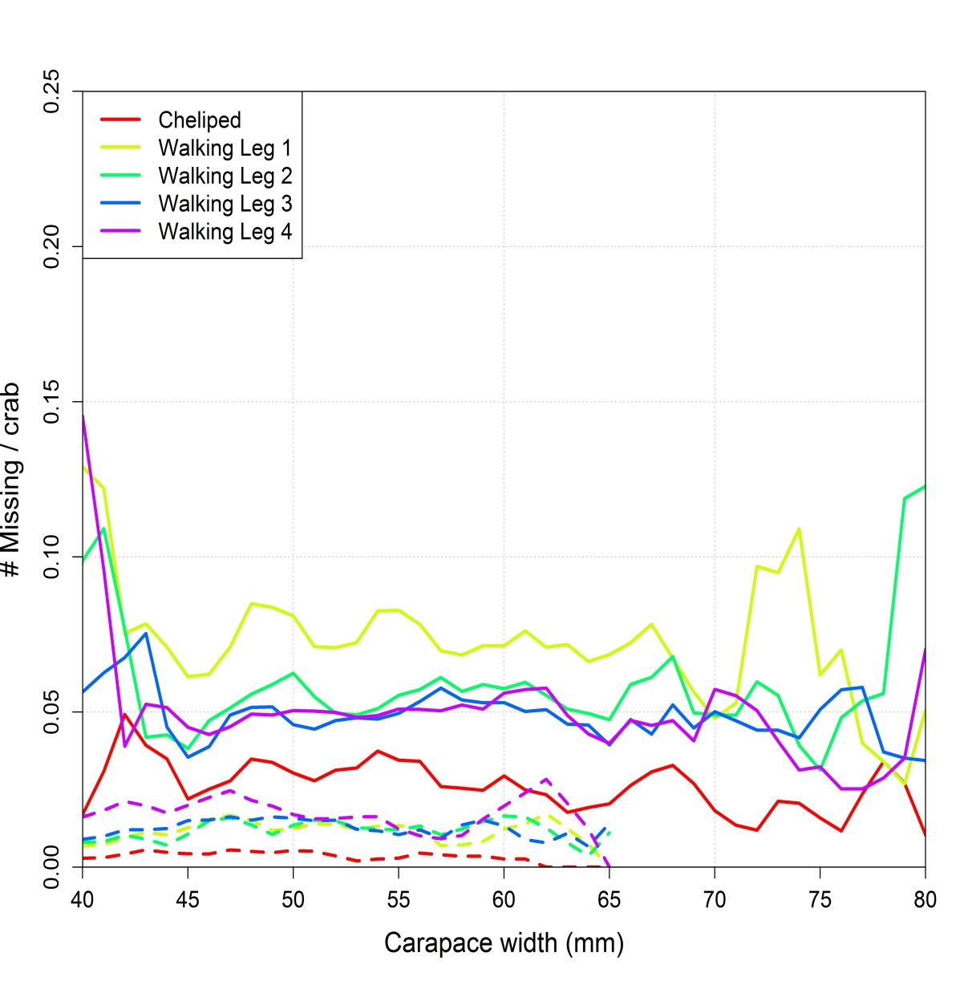
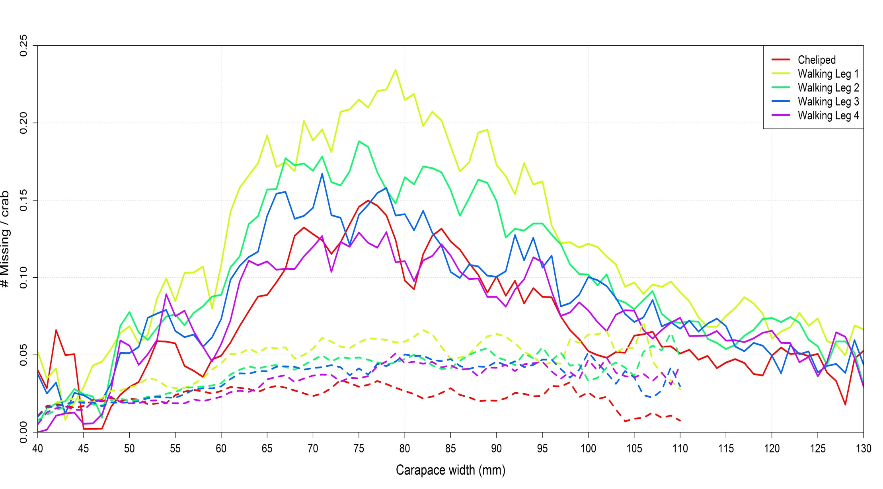
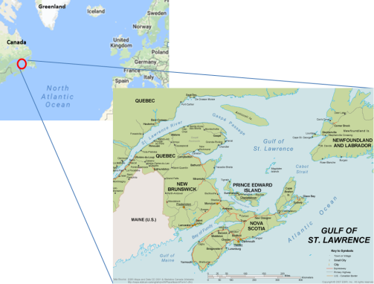
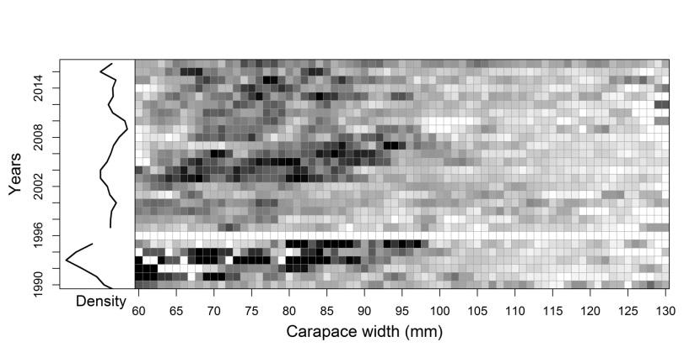


Pereiopod Loss Rates in a Population of Snow Crab (Chionoecetes opilio) in the Southern Gulf of Saint Lawrence, Canada
Tobie Surette, Mikio Moriyasu and Renée Allain
Background
Crab pereiopods, i.e. the chelipeds (claws) and walking legs, can be lost via predation, competition, moulting or commercial fishing activity.
The snow crab is a homochelous decapod, i.e. the left and right chelipeds are morphologically identical.
Snow crab may regenerate lost pereipods over a 2-3 successive moults.
The rates at which pereiopods are lost were determined from observational data gathered from a long-running annual trawl survey, now in its 30th year, from the southern Gulf of Saint Lawrence in eastern Canada:
The local fishery is on the order of 25000 tonnes per year, leading to annual revenues in the hundreds of millions $CAN.
Only larger males are fished. Females lie below the legal size limit.
Landed crab with missing pereiopods have lower commercial value.
Results
Sex, Size & Maturity
Males have much higher loss rates than females with similar size and maturity stage.
The most commonly lost pereiopod among mature crab and immature males is the 1st walking leg while the least commonly lost one is the cheliped.
Only among mature males do the loss rates vary with size: mid-sized male rates are on average up to 4 times higher than those of larger males.
Similarly, small mature male crab have much lower loss rates than mid-sized mature males, though the number of samples is low at these sizes so the corresponding rates are more uncertain.
Mature crab lose their pereiopods 2 to 5 times more than immature crab of comparable sizes.
Variation through time
Loss rates among mid-sized mature males is generally high through time, but there are periodic pulses where rates are relatively higher and these correlate with higher abundance of commercial-sized males.
2017 stands out from others in having high rates across all sizes, even among larger crab. This year was also associated with an exceptionally high mortality event.
Results
Geographic Variation
Rates are higher in mid-northern regions, which correspond to deeper water regions.
Other regions such as the easternmost and southwestern, associated with high densities of crab, show only a low or moderate rate of leg loss.
Oddly, local high rates of missing pereiopods among mid-sized mature males are poorly predicted by high densities of larger mature males or low mature female densities, though this may be due to removal of larger males by the fishery.
Missing 1st
walking leg
Female
Male
Female
Mature
Cheliped
1st walking leg
2nd walking leg
Male
Mature
Immature
Missing 3rd walking leg
Average pereiopod loss among mature males (60+ mm cw) by geographic region over the 2008-2017 surveys.
4th walking leg
Immature
Pereiopod idendification for male (bottom) and female (top) snow crab. The male has a single missing pereiopod while the female has a missing cheliped and 1st walking leg on the left side.
Average pereiopod loss rates for females (left) and males (right) as a function of crab size for each of the 5 leg positions (colors) for mature (solid lines) and immature (dashed lines) crab. Lines are average rates based on survey observations from 2008 to 2017.
Discussion
The strong size and maturity dependence among males strongly hints at intra-specific competition as a major factor in leg loss. One reasonable hypothesis is that competition between stronger larger males and weaker, smaller ones lead to increased leg loss in the latter.
Previous studies showed that predators in the southern Gulf have a fairly limited range of crab sizes which they can eat. Any hypothetical predator leading to increases in loss rates must have a differential effect by maturity stage in order to be a major cause of leg loss.
Commercially fished crab (mature males 95+ mm cw) crab, have much lower leg loss rates than smaller unfished mature males. Similarly, larger immature males, which are often fished but rejected as by-catch, show no corresponding increase over commercial sizes. This strongly hints that the fishery is a minor contributor to overall leg loss among males.
Future Goals
Develop a model to predict the rates of mid-sized mature males as a function of the abundance of groups of larger males.
Explore correlations between pereiopod loss probabilities. For example, how does the loss of a cheliped affect the probability of losing other pereiopods?
Do loss rates vary with local mature female density, for instance through increase of competition for copulation?
Goal
Compare pereiopod loss rates between sexes, maturity stages and crab sizes in a natural population and explore its relation with population density.
Variation of overall pereiopod loss versus crab size through time for mature males. Black squares indicate higher rates. The left panel shows the mean abundance of commercial (i.e. large) crab. Survey year 1996 was incomplete. White squares indicate missing or too few data.
Acknowledgements
Thanks to the DFO trawl survey research team: M. Hebert and J.-F. Landry .
Financing for this project was through a DFO/Industry collaborative agreement.
Gulf Fisheries Centre, 343 University Avenue.
Moncton, New Brunswick, Canada E1C 5K4
Notes:
841 x 1189

Slide 2
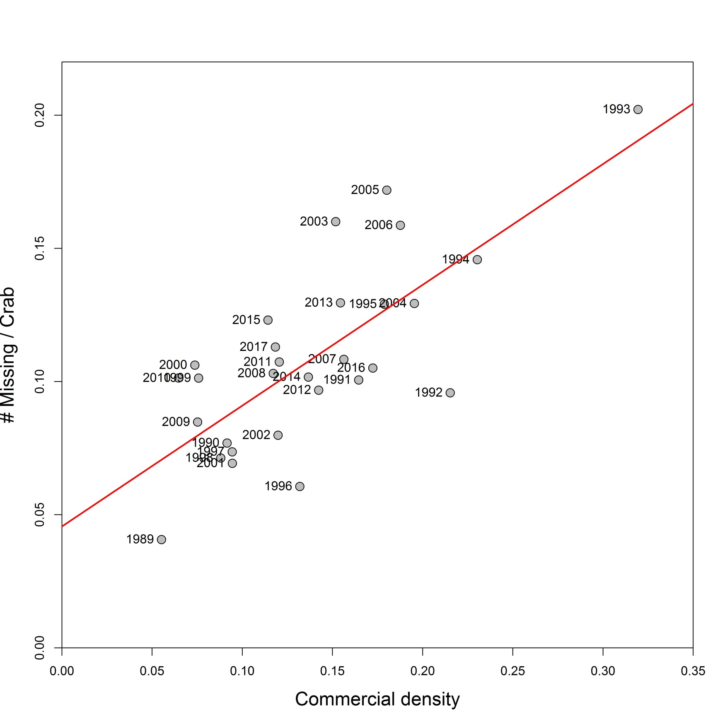

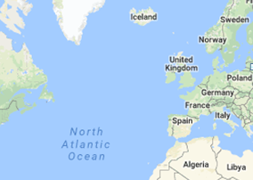
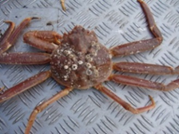
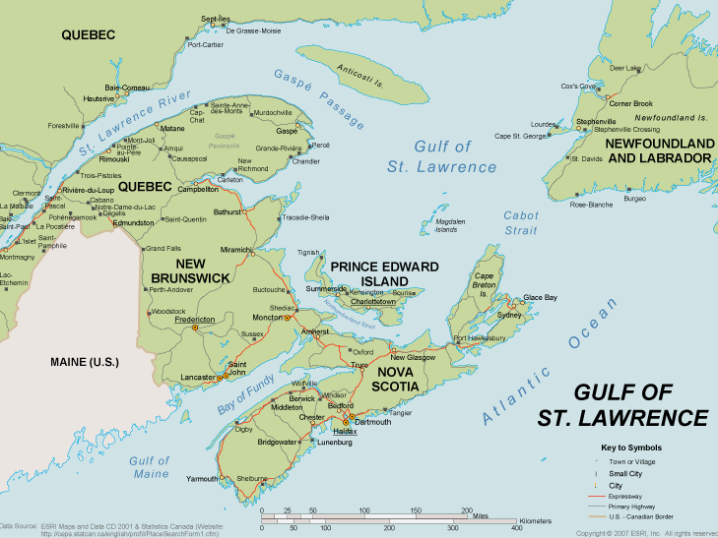
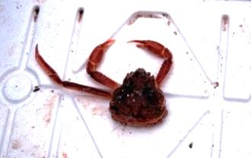
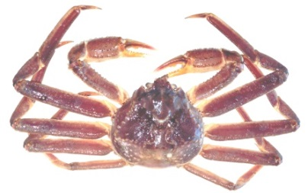
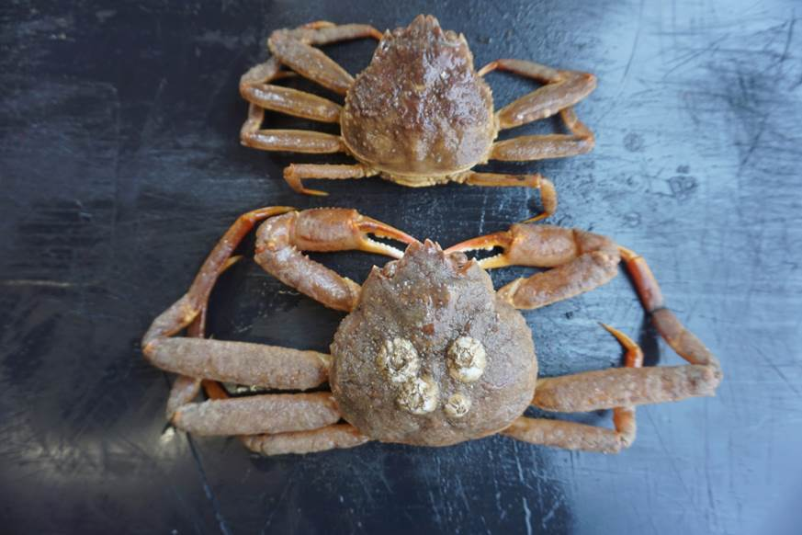
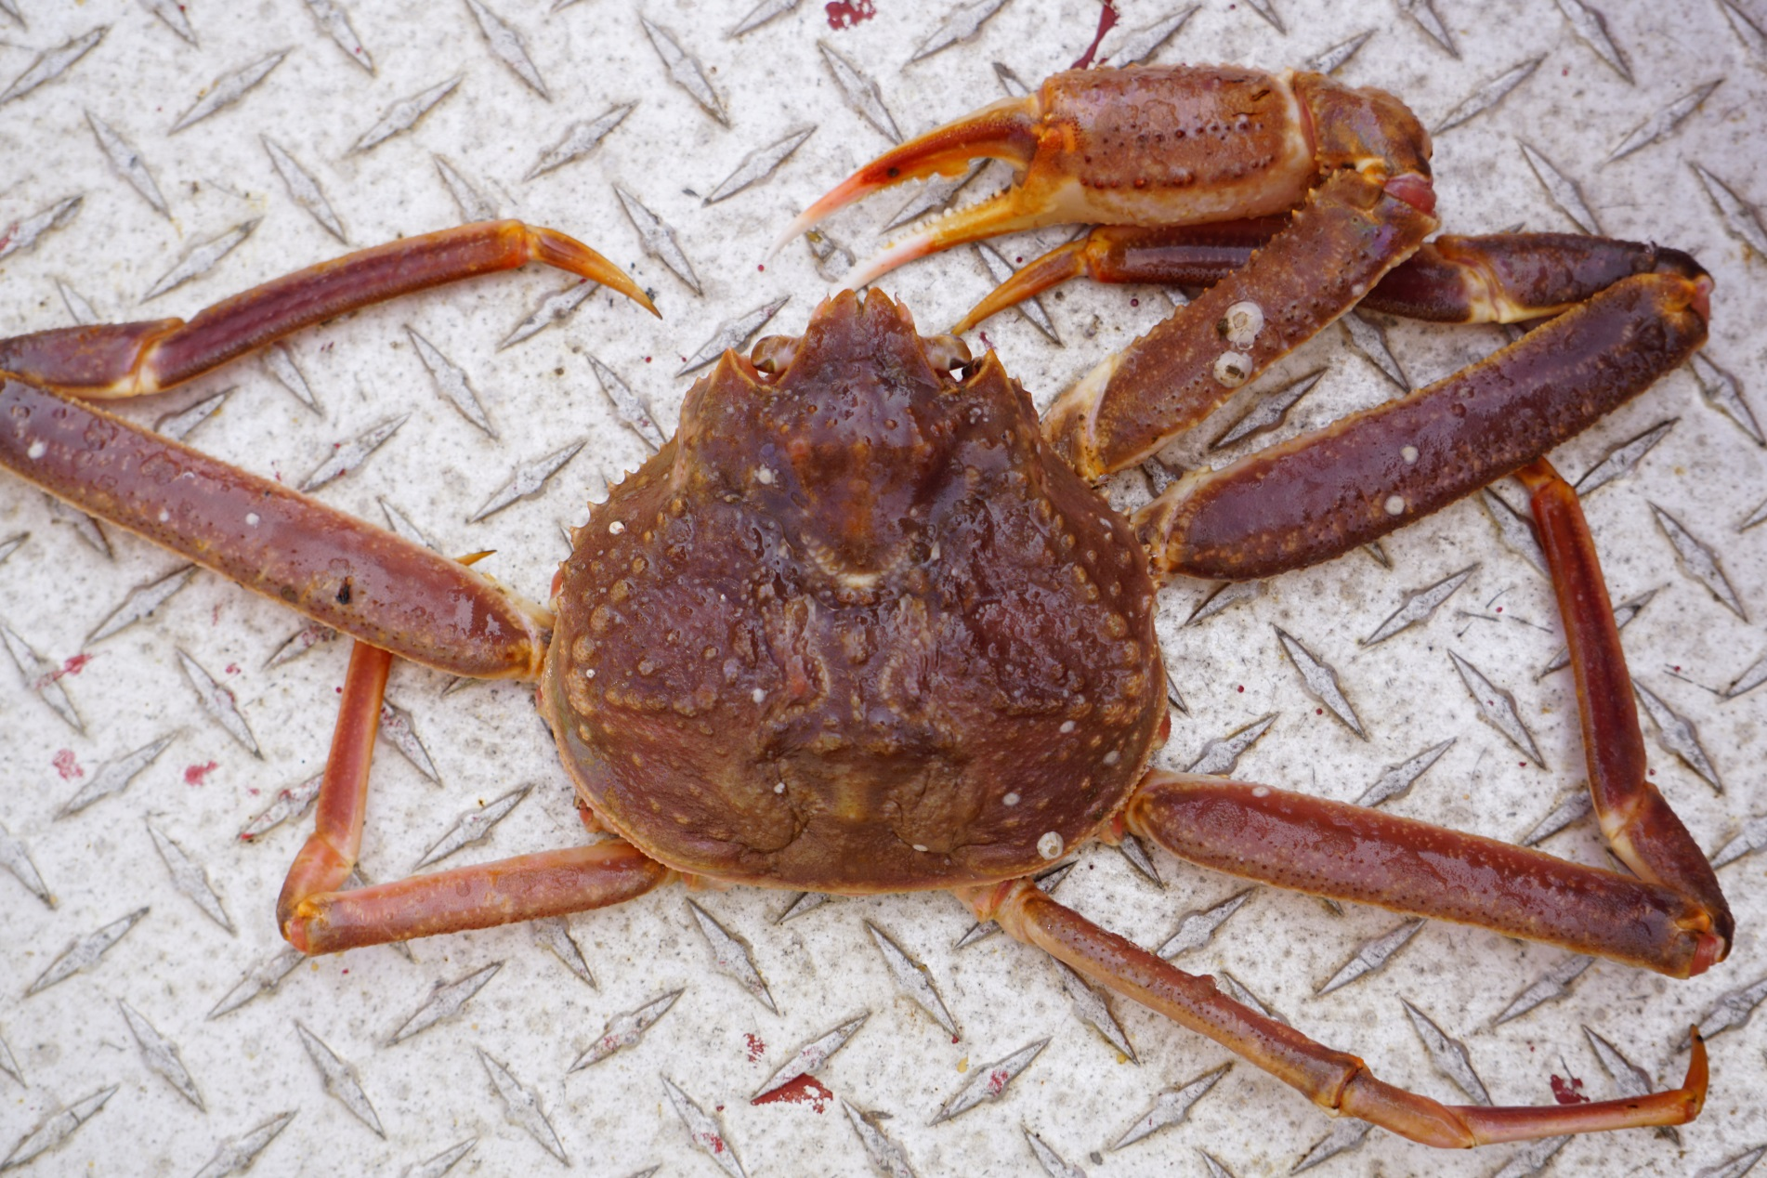
Figures & Photos:
Female
Male
Mature
Mature
Immature
Immature
Average missing pereiopod rates for females (left) and males (right) as a function of crab size for each of the 5 leg positions (colors) for mature (solid lines) and immature (dashed lines). Lines are group rates from 2008 to 2017 survey observations.
Average pereiopod loss among mature males by geographic region over the 2008-2017 surveys.
Greenland
Plot of overall missing pereiopod rates of mid-sized (60-95 mm cw) as a function of the density of commercial-sized crab.
Canada
Male snow crab with missing 3rd walking leg (left) and cheliped (right).
Variation of overall pereiopod loss versus crab size through time for mature males. Black squares indicate higher rates. The left panel shows the mean abundance of commercial (i.e. large) crab. Survey year 1996 was incomplete. White squares indicate missing or too few data.
Missing cheliped
Missing cheliped &
1st walking leg
Female
Female
Cheliped
Cheliped
Missing 1st walking leg
1st walking leg
Male
2nd walking leg
Male
2nd walking leg
Missing 3rd walking leg
3rd walking leg
4th walking leg
4th walking leg
Pereiopod idendification for male (bottom) and female (top) snow crab. The male has a single missing pereiopod while the female has a missing cheliped and 1st walking leg on the left side.

